Slide 1
Three birds (in the LLOD cloud) with one stone: BabelNet, Babelfy and the Wikipedia Bitaxonomy
Tiziano Flati and Roberto Navigli
Notes:
1

Slide 2
Three services in the Linguistic LOD cloud
We present three services in the Linguistic Linked Open Data cloud
BabelNet
Babelfy
The Wikipedia Bitaxonomy
Querying, exploring and exporting data into RDF format
Closely intertwined and beneficial to each other
Multilingual (50 languages!)

Slide 3
babelnet.org

Slide 4
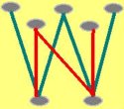
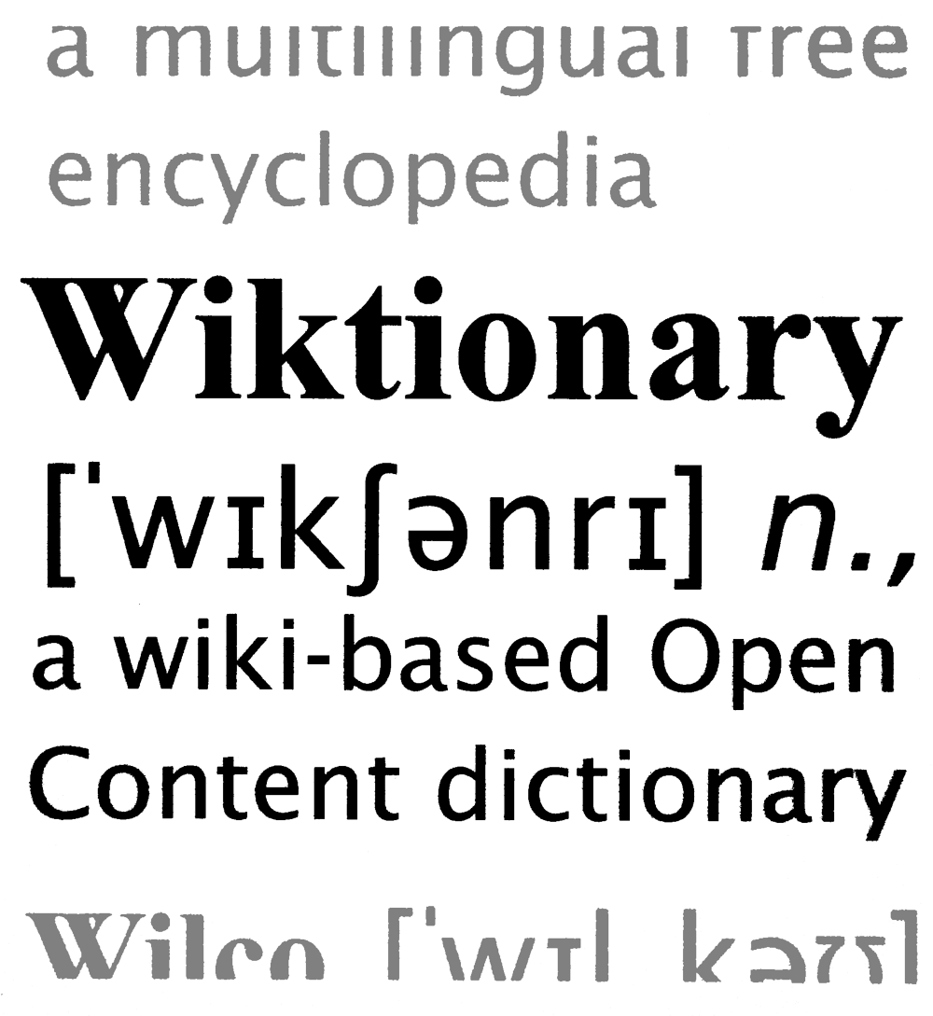
BabelNet
Traditional lexical resources
Collaborative lexical resources
OM
fully-structured
manually curated by experts
available for a few languages
difficult to maintain and update
semi-structured
collaboratively built by the crowd
highly multilingual
up-to-date

Slide 5
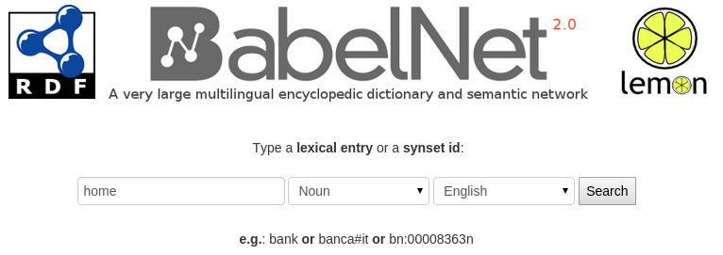
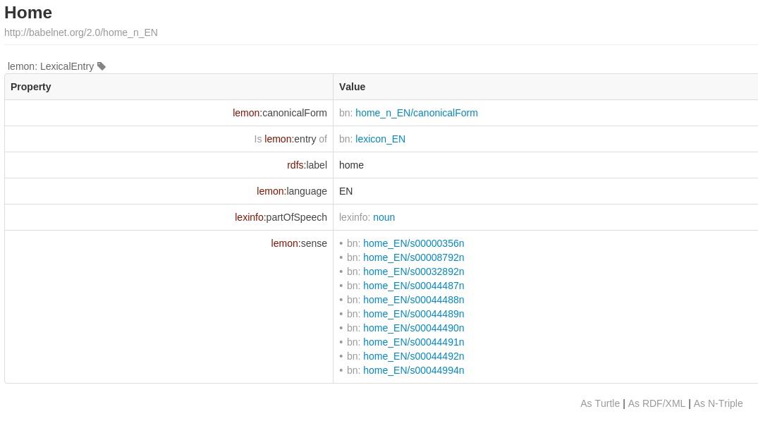
babelnet.org:8084/sparql/

Slide 6
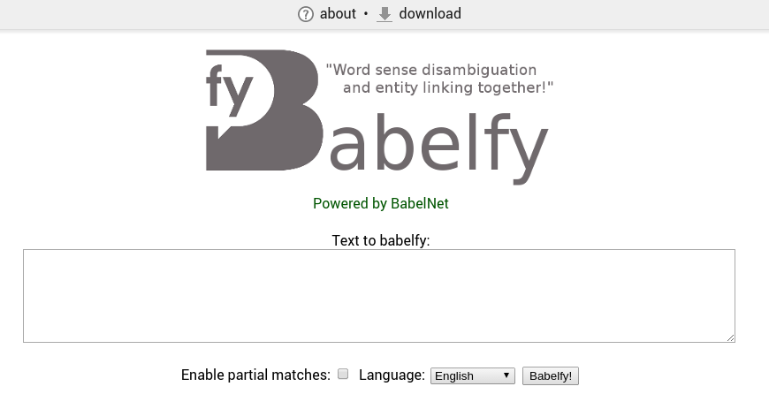
babelfy.org

Slide 7
Hercules is a 1997 American animated musical fantasy film produced by Walt Disney Feature Animation and released by Walt Disney Pictures. The 35th animated feature in the Walt Disney Animated Classics series, the film was directed by Ron Clements and John Musker. The film is loosely based on the legendary Greek mythology hero Heracles (known in the film by his Roman name, Hercules), the son of Zeus, in Greek mythology.

Slide 8
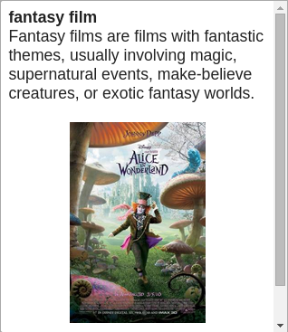
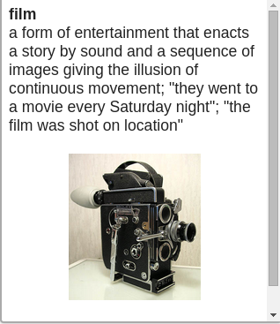
Hercules is a 1997 American animated musical fantasy film produced by Walt Disney Feature Animation and released by Walt Disney Pictures. The 35th animated feature in the Walt Disney Animated Classics series, the film was directed by Ron Clements and John Musker. The film is loosely based on the legendary Greek mythology hero Heracles (known in the film by his Roman name, Hercules), the son of Zeus, in Greek mythology.

Slide 9
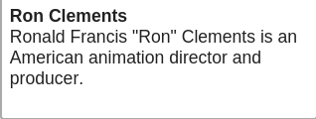
Hercules is a 1997 American animated musical fantasy film produced by Walt Disney Feature Animation and released by Walt Disney Pictures. The 35th animated feature in the Walt Disney Animated Classics series, the film was directed by Ron Clements and John Musker. The film is loosely based on the legendary Greek mythology hero Heracles (known in the film by his Roman name, Hercules), the son of Zeus, in Greek mythology.

Slide 10
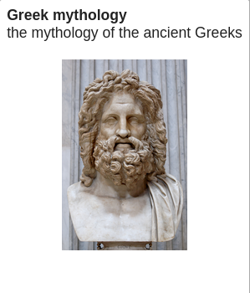
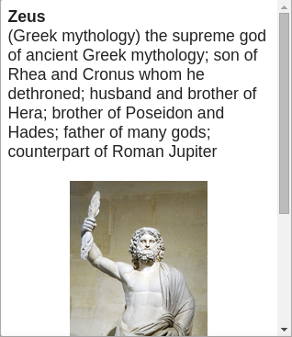
Hercules is a 1997 American animated musical fantasy film produced by Walt Disney Feature Animation and released by Walt Disney Pictures. The 35th animated feature in the Walt Disney Animated Classics series, the film was directed by Ron Clements and John Musker. The film is loosely based on the legendary Greek mythology hero Heracles (known in the film by his Roman name, Hercules), the son of Zeus, in Greek mythology.

Slide 11
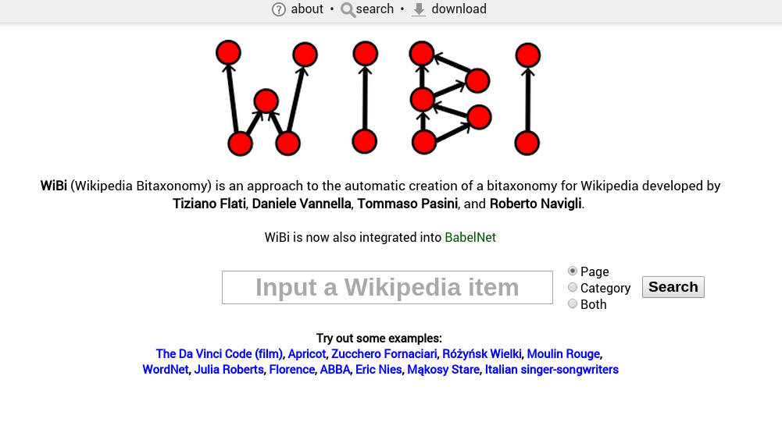
wibitaxonomy.org

Slide 12
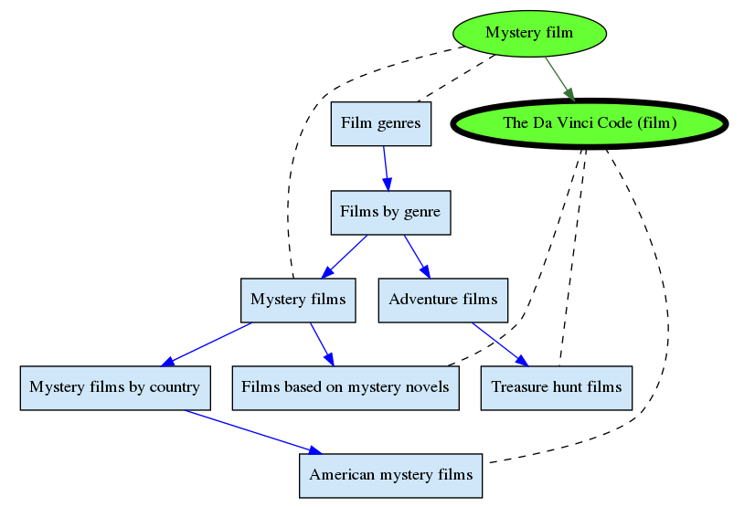

Slide 13
Tiziano Flati and Roberto Navigli
Linguistic Computing Laboratory
http://lcl.uniroma1.it
Notes:
13

