Slide 1
2 Is Bigger (and Better) Than 1: the Wikipedia Bitaxonomy Project
T. Flati, D. Vannella, T. Pasini, R. Navigli
ERC Starting Grant MultiJEDI No. 259234
Notes:
Hi everybody…
Joint work with …
At Sapienza
Work funded by erc

Slide 2
The Wikipedia structure
Article pages
~4M
Category pages ~ 700K
Two noisy graphs with no explicit hypernym relation.
Notes:
As you know, in wikipedia there are 2 kind of items :
pages that describes either a concept or a real world entity and
Categories that categorizes pages by topics.
So we can represent these 2 sets as graphs, on the left side we have the wikipedia article graph in which 2 pages can be connected by many kind of relation, it is very huge and count 4M pages.
on the right side there we have the wikipedia category graph, it is ways smaller and has some kind of hierarchical structure.
These 2 graphs are connected thanks to wikipedians effort that categorize pages into categories.

Slide 3
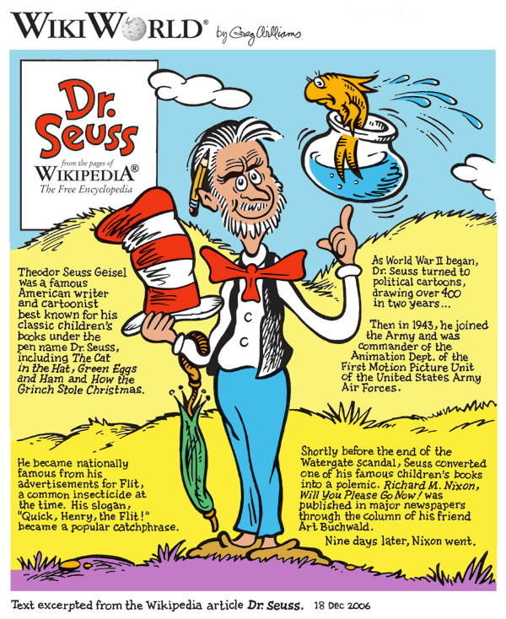
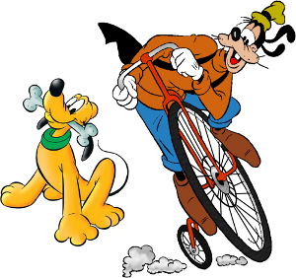
The Wikipedia structure: an example
Pages
Categories
Fictional characters
Mickey Mouse
Cartoon
The Walt Disney Company
Fictional characters by medium
Comics by genre
Donald Duck
Disney character
Disney comics
Funny Animal
Disney comics characters
Superman
Notes:
As u can see in the example donald duck page has several kind of relation with other pages
And in the category graph there is a hierachical structure, infact Disney compics characters is in hypernym relation with Disney Character this is not the case for Disney comics.

Slide 4
Our goal
To automatically create a Wikipedia Bitaxonomy for Wikipedia pages and categories in a simultaneous fashion.
pages
categories
Notes:
So starting from the two noisy graphs seen before we want to build a wikipedia bitaxonomy, two taxonomy aligned to each other, for pages and categories.

Slide 5
Our goal
To automatically create a Wikipedia Bitaxonomy for Wikipedia pages and categories in a simultaneous fashion.
KEY IDEA
The page and category level are mutually beneficial for inducing a wide-coverage and fine-grained integrated taxonomy
Notes:
So starting from the two noisy graphs seen before we want to build two taxonomy in a simoultaneous fashion, starting a mutually beneficial cycle, so that creating the taxonomy for one side we also explot it to enrich the taxonomy of the other side.

Slide 6
Key idea
Pages
Categories
is a
Fictional characters
is a
is a
Mickey Mouse
Cartoon
The Walt Disney Company
Fictional characters by medium
Comics by genre
is a
is a
is a
is a
Donald Duck
is a
Disney character
Disney comics
is a
Disney comics characters
Funny Animal
Superman
Notes:
This procedure outputs a bitaxonomy for both wikipedia pages and categories.
As you can see in both taxonomies there is only the hypernym relation,all others are cutted out.
Examples

Slide 7
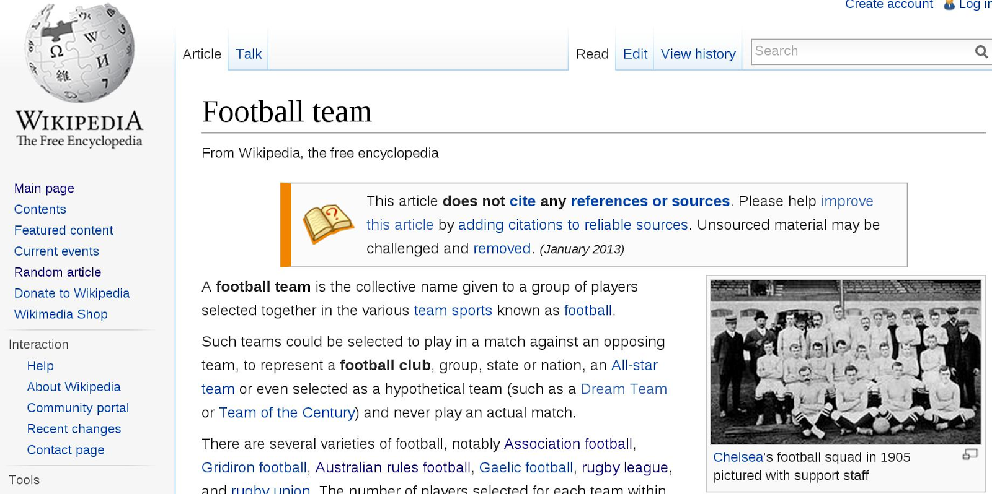
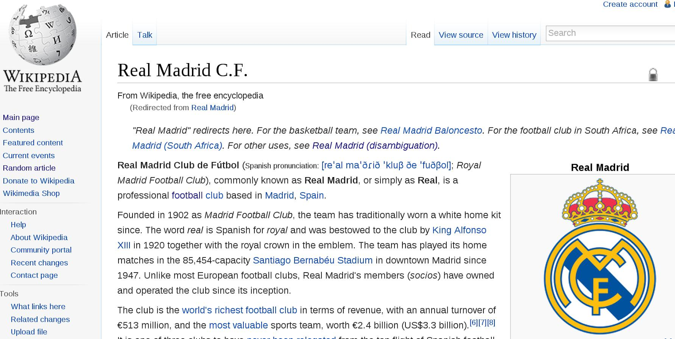
What is a taxonomy
ταξις, taxis
"arrangement"
+
νομος, nomos
"law"
A taxonomy is a classification
or categorization of a complex system.
Football team
is a
Real Madrid C.F.

Slide 8
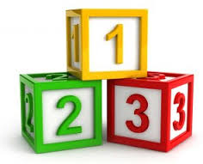
A 3-phase method
Starting from two noisy graphs
pages
categories
Notes:
We propose a three phase method that, starting frome two noisy graphs, for wikipedia pages and categories that we have described so far

Slide 9
A 3-phase method
1. Build the page taxonomy
pages
Notes:
First builds a taxonomy for pages

Slide 10
A 3-phase method
1. Build the page taxonomy
2. Bitaxonomy Algorithm
categories
pages
Notes:
Then apply an iterative algorithm that, exploiting the page taxonomy, builds the category taxonomy from scratch and wile doing this uses the information found in the category taxonomy, built so far, to enrich the page taxonomy

Slide 11
A 3-phase method
1. Build the page taxonomy
2. Bitaxonomy Algorithm
pages
categories
Notes:
This can be done thanks to the edges connecting the two taxonomies, categorizing each wikipedia page in a category.
. This procedure will be clearer explained later in the presentation

Slide 12
A 3-phase method
1. Build the page taxonomy
2. Bitaxonomy Algorithm
3. Refine the category taxonomy
+50%
categories
pages
categories
Notes:
At the end of the iterative method we refine the built category taxonomy covering additional 50%
(that means 2 thousand hundred more categories)

Slide 13
Contributions
Self-contained approach
Page taxonomy and category taxonomy built simultaneously
State-of-the-art results when compared to all other available taxonomies
Notes:
It is a self contained approach, that use no external resources (such as wordnet or babelnet).
Builds simoultaneously two taxonomy, for pages and categories of wikipedia, achieving state of the art results when compared To other resources

Slide 14
The WiBi Page taxonomy
1
Notes:
So now I want to go into details about the first phase.
It aims at building a taxonomy for wikipedia pages,

Slide 15
Assumptions
The first sentence of a page is a good definition (also called gloss)
Notes:
We first assume, according to wikipedia guide lines, that the first sentence of a page is a good definition (or gloss) for that page.
For example “Scrooge mcduck is a cartoon character created in 1947 …..” is the gloss for the page Scrooge McDuck.
We will see how we exploit this definition in order to extract the correct hypernym for a given page.

Slide 16
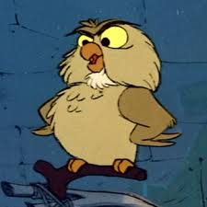
The WiBi Page taxonomy
[Syntactic step] Extract the hypernym lemma from a page definition using a syntactic parser;
[Semantic step] Apply a set of linking heuristics to disambiguate the extracted lemma.
Scrooge McDuck is a character […]
Syntactic step
nn
nsubj
Hypernym lemma: character
Scrooge McDuck is a character[…]
cop
Semantic step
A
Notes:
This phase is also divided in 2 sub-steps, the syntactic step extracts the hypernym lemma for a given page, the second aims at disambiguating the hypernym lemma extraced in the precious step.
So for example given the page for Scrooge we apply the syntactic step and gives as output “character” as hypernym lemma for that page, then the semantic step tries to disambiguate it choosing the most suitable sense in wikipedia and outputs a page that is the hypernym for the Scrooge McDuck page.

Slide 17
The syntactic step
“Aristotle was a Greek philosopher,
a student of Plato and teacher of Alexander the Great.”

Slide 18
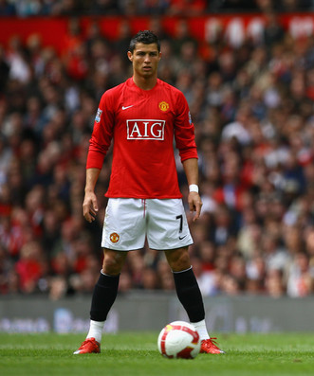
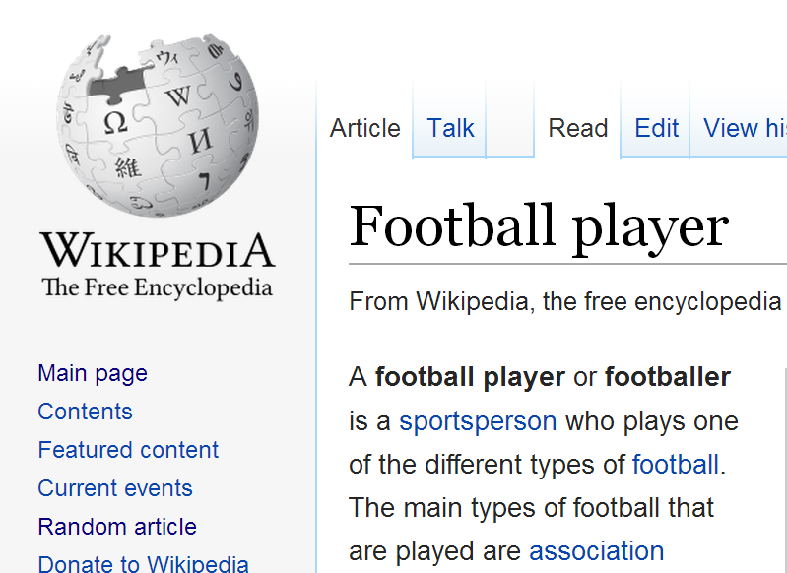
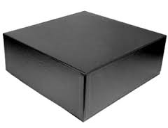
The semantic step
Linking heuristic
Crowdsourced
Category
Multiword
Monosemous
Distributional
Target page (Cristiano Ronaldo)
Disambiguated
hypernym (Football player)
Ambiguoushypernym
(‘player’)
5 cascading
linking heuristics
Notes:
To solve the disambiguation problem in the semantic step, we applied 5 cascading heuristics, that given as input a page, in this case the one for Cristiano Ronaldo, and the candidate hypernym lemma, in this case player, gives as output the disambiguation for the hypernym lemma and so the hypernym page for the target page.
The first two heuristics, Crowdsourced and category are the ones that contribute the most to disambiguate the hypernyms and so i’m going to explain them in the next slides.

Slide 19
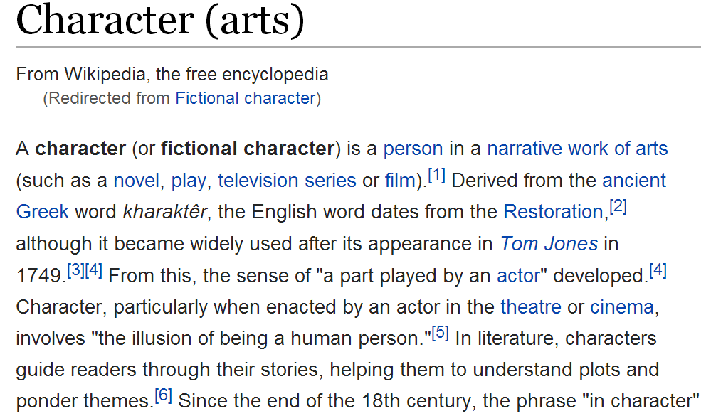
1. Crowdsourced heuristic
Use the links from the crowd!
Mickey Mouse is a funny animal cartoon character and the official mascot of The Walt Disney Company.
Notes:
This heuristic exploits the linked lemmas in the page gloss. So if any wikipedians linked the hypernym lemma in the gloss,
we thanks him and just take the page linked as disambiguation for the lemma.
Example

Slide 20
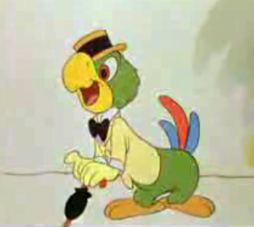
2. Category heuristic
Given a page and its ambiguous hypernym, exploit its categories to build a distribution of the hypernym’s senses.
Donald Duck
Pluto
Characters in Disney package films
Hook
Disney comics characters
Mickey Mouse
Ambiguous hypernym: Character
Goofy
José Carioca
Notes:
The category heuristic is a little bit trickyer.
Given a page and his hypernym lemma , it takes all its categories and all the pages in these categories.
So given all these pages it takes theyr glosses and each category build a distribution for all the senses for the hypernym lemma
Founded in the page glosses so as in the example ….
Once it has calculated the distributions for each category it merges them in

Slide 21
2. Category heuristic
Given a page and its ambiguous hypernym, exploit its categories to build a distribution of the hypernym’s senses.
Pluto, also called Pluto the Pup, is a cartoon character […]
Donald Duck
Pluto
Characters in Disney package films
Captain James Hook is a fictional character […]
Hook
Mickey Mouse is a funny animal cartoon character […]
Mickey Mouse is a funny animal cartoon character […]
Disney comics characters
Mickey Mouse
Ambiguous hypernym: Character
Goofy is a funny animal cartoon character […]
Goofy
José Carioca is a Disney cartoon character […]
José Carioca
Notes:
The category heuristic is a little bit trickyer.
Given a page and his hypernym lemma , it takes all its categories and all the pages in these categories.
So given all these pages it takes theyr glosses and each category build a distribution for all the senses for the hypernym lemma
Founded in the page glosses so as in the example ….
Once it has calculated the distributions for each category it merges them in

Slide 22
2. Category heuristic
Given a page and its ambiguous hypernym, exploit its categories to build a distribution of the hypernym’s senses.
Pluto, also called Pluto the Pup, is a cartoon character […]
Donald Duck
Characters in Disney package films
Character (arts) 5, Funny animal 1
Captain James Hook is a fictional character […]
Mickey Mouse is a funny animal cartoon character […]
Mickey Mouse is a funny animal cartoon character […]
Disney comics characters
Character (arts) 3, Funny animal 1, Cartoon 1
Ambiguous hypernym: Character
Goofy is a funny animal cartoon character […]
Character(arts) 8, Funny animal 2, Cartoon 1
José Carioca is a Disney cartoon character […]
Notes:
The category heuristic is a little bit trickyer.
Given a page and his hypernym lemma , it takes all its categories and all the pages in these categories.
So given all these pages it takes theyr glosses and each category build a distribution for all the senses for the hypernym lemma
Founded in the page glosses so as in the example ….
Once it has calculated the distributions for each category it merges them in

Slide 23
2. Category heuristic
Given a page and its ambiguous hypernym, exploit its categories to build a distribution of the hypernym’s senses.
Donald Duck
Ambiguous hypernym: Character
Character(arts)
Character(arts) 8, Funny animal 2, Cartoon 1
Notes:
one single distribution that will be the final sense distribution for the hypernym lemma, then it will choose the most frequent sense in the distribution as disambiguation for the hypernym lemma

Slide 24
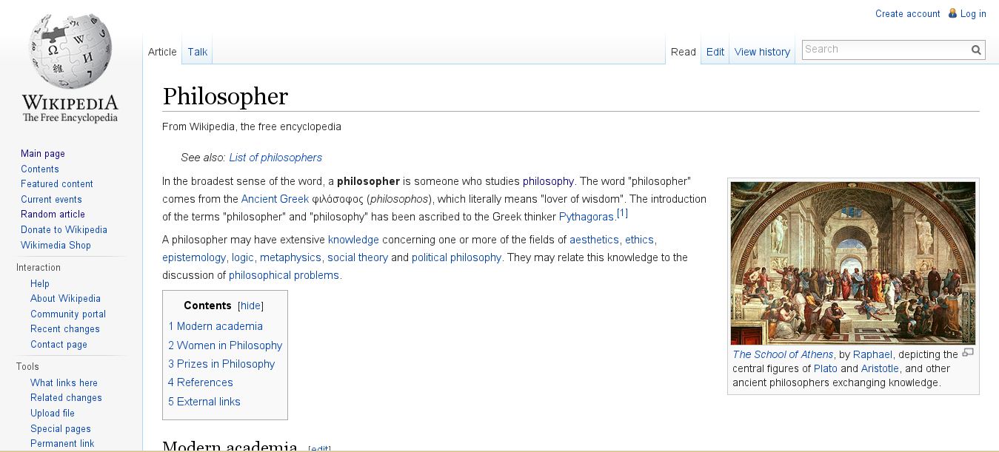
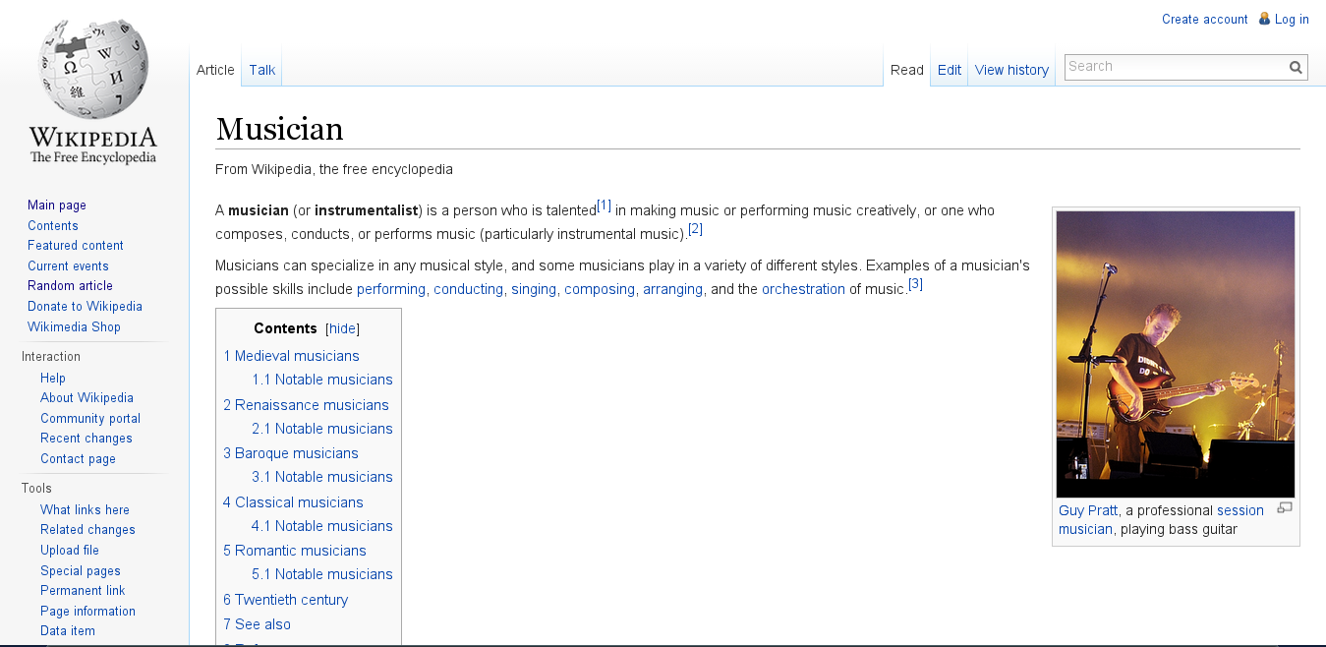
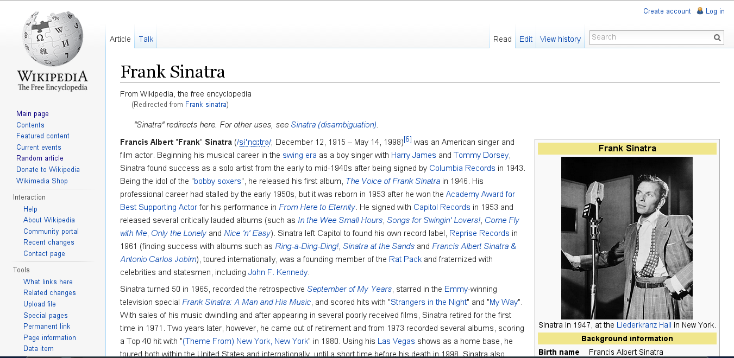
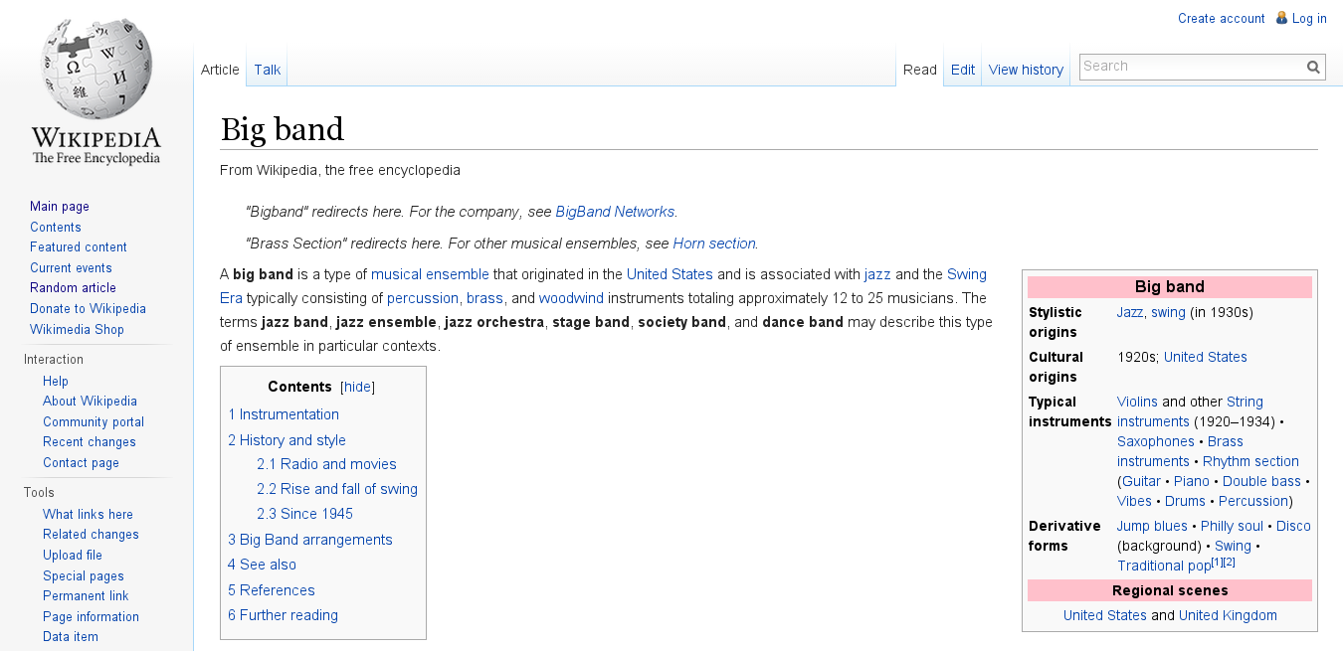
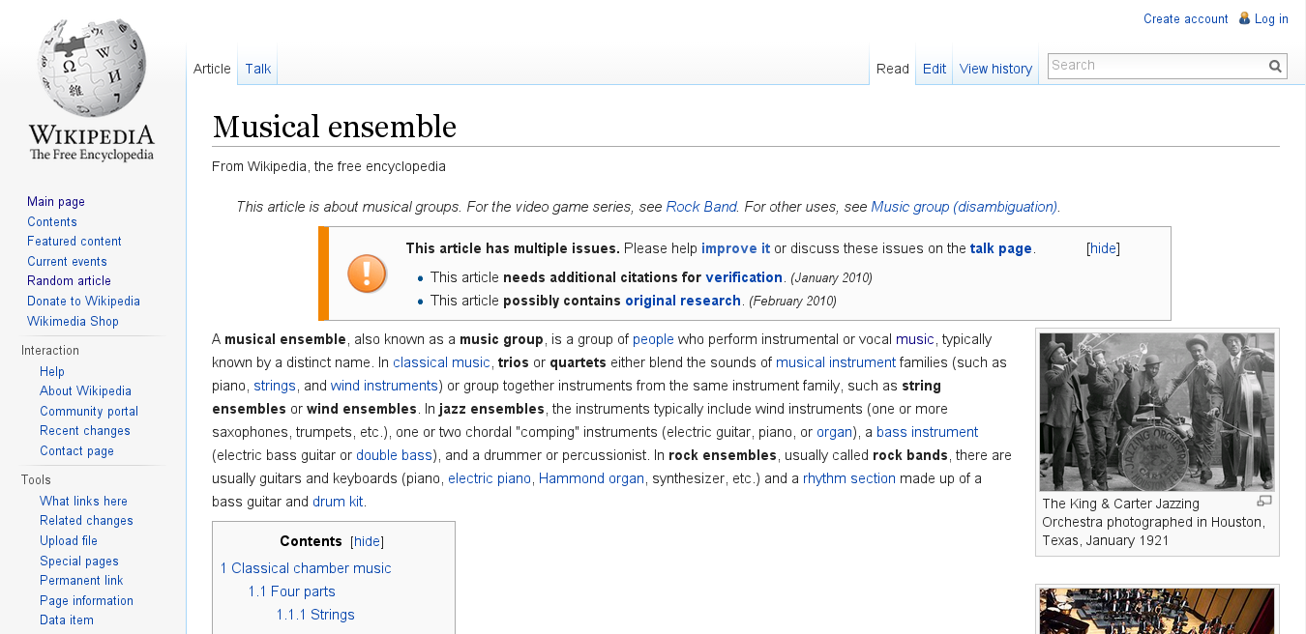
Distributional heuristic
Exploit the context of the glosses where the lemma is linked
Hypernym lemma: character
s
Mickey_Mouse:100, cartoon:89, TV:34, Goofy:10…
s’
Unicode:100, font:92, encoding:24, keyboard:15
Notes:
We exploit the context of the linked occurrences of the lemma

Slide 25
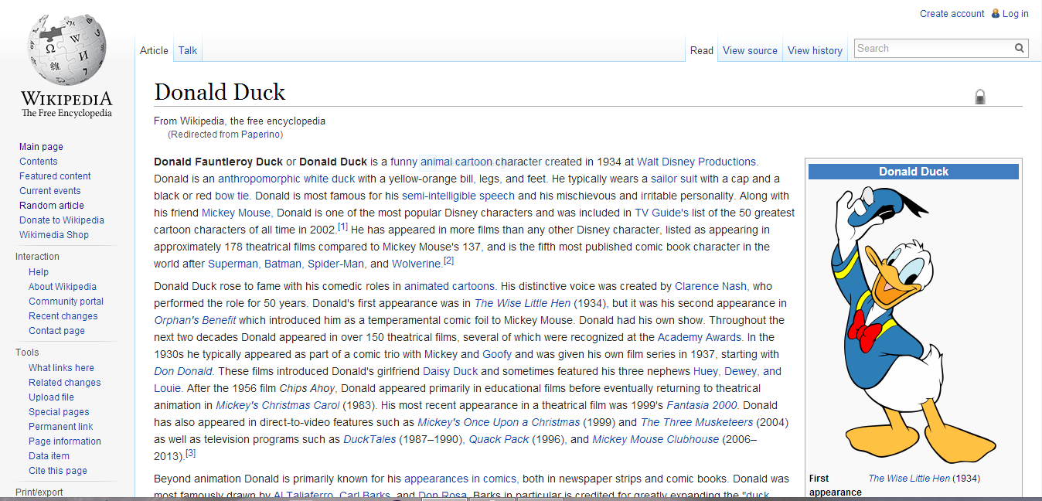
Distributional heuristic (15%)
Build the vector v for the target page
Build a vector s for each sense of the lemma
Compute dot product s x v
Select the best sense s
v
Animal:1, cartoon:1, funny:1, Walt_Disney:1
s
Mickey_Mouse:100, cartoon:89, TV:34, Goofy:10…
score(v, s)

Slide 26
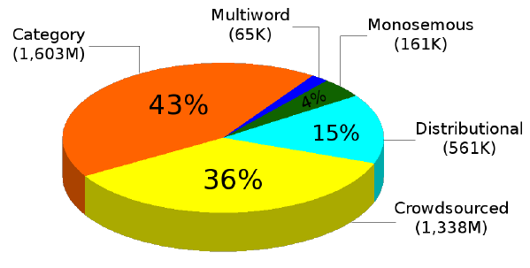
Page taxonomy linking heuristics
3
4
Multiword (65K)
Monosemous (161K)
Category (1.603M)
2
5
Distributional (561K)
Crowdsourced (1.338M)
1
Notes:
The pie represents the fraction of the number of times a heuristic contribute to disambiguate a hypernym lemma
We saw the two most contributing heuristics category and crowdsourced, then follow distributional monosemouse and multiword.

Slide 27
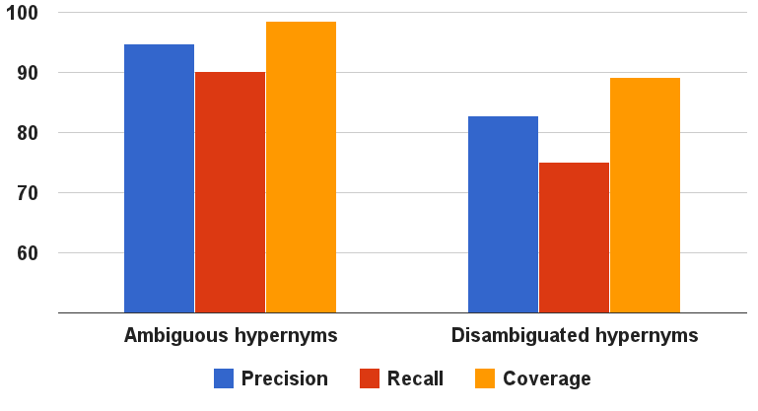
Page taxonomy evaluation
Notes:
So far we built the page taxonomy, so we choose to evaluate it. As u can see we have a really high performance, more than 90%, on the ambiguous hypernyms extracted in the syntactic stem, and still good performance, around 80%, on the disambiguated hypernyms.

Slide 28
Measures
The average ratio of correct hypernym lemmas (senses) to the total number of lemmas (senses) returned for the 1,000 pages in the dataset.
Precision
Recall
Coverage
The number of correct lemmas (senses) over the total number of lemmas (senses) in the dataset.
The fraction of pages for which at least one lemma was returned, independently of its correctness.

Slide 29
Measures
Specificity
Granularity
The percentage of times a system outputs a more specific answer than another system.
It is determined by drawing each resource on a bidimensional plane with the number of distinct hypernyms on the x axis and the total number of hypernyms (i.e., edges) in the taxonomy on the y axis.

Slide 30
The story so far
1
Noisy page graph
Page taxonomy
Notes:
We have obtained a first version of the page taxonomy
I want now to invite Tiziano Flati on the stage to explain you in details the second and third phase, in wich we build the category taxonomy and improove the statistics for the page taxonomy built so far.
Thank you very much for the attenction.

Slide 31
The Bitaxonomy
algorithm
2
Notes:
Now that we have a (partial) page taxonomy, we want to create a taxonomy for categories as well

Slide 32
The Bitaxonomy algorithm
The information available in the two taxonomies is mutually beneficial;
At each step exploit one taxonomy to update the other and vice versa;
Repeat until convergence.

Slide 33
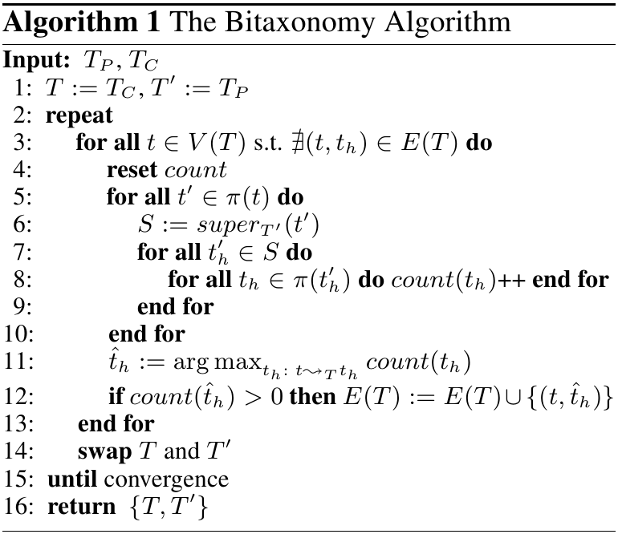

Slide 34
The Bitaxonomy algorithm
Starting from the
page taxonomy
Football team
Football teams
is a
Football clubs
Atlético Madrid
Real Madrid F.C.
Football clubs
in Madrid
pages
categories

Slide 35
The Bitaxonomy algorithm
Exploit the cross links to infer hypernym relations in the category taxonomy
Football team
Football teams
is a
is a
Football clubs
Atlético Madrid
Real Madrid F.C.
Football clubs
in Madrid
pages
categories

Slide 36
The Bitaxonomy algorithm
Football team
Football teams
is a
is a
is a
Football clubs
Atlético Madrid
Real Madrid F.C.
Football clubs
in Madrid
Take advantage of cross links to infer back is-a relations in the page taxonomy
pages
categories

Slide 37
The Bitaxonomy algorithm
Football team
Football teams
is a
is a
is a
is a
Football clubs
Atlético Madrid
Real Madrid F.C.
Football clubs
in Madrid
Use the relations found in previous step to infer new hypernym edges
pages
categories

Slide 38
The Bitaxonomy algorithm
Mutual enrichment of both taxonomies until convergence
Football team
Football teams
is a
is a
is a
is a
Football clubs
Atlético Madrid
Real Madrid F.C.
Football clubs
in Madrid
pages
categories

Slide 39
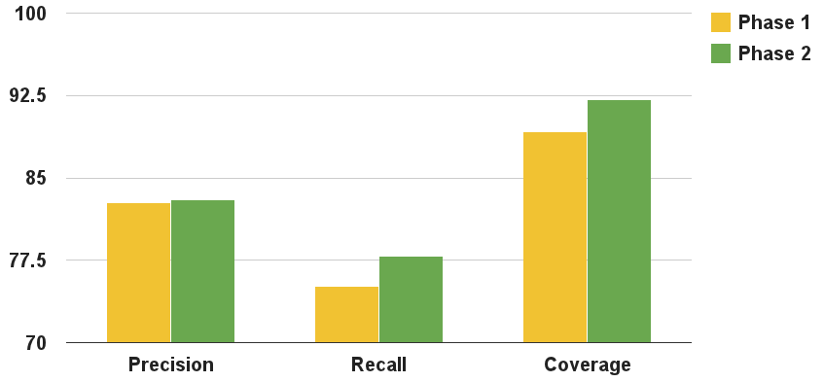
Page taxonomy evaluation (cont’d)
Sensible 3% increment in terms of recall and coverage, with unvaried precision

Slide 40
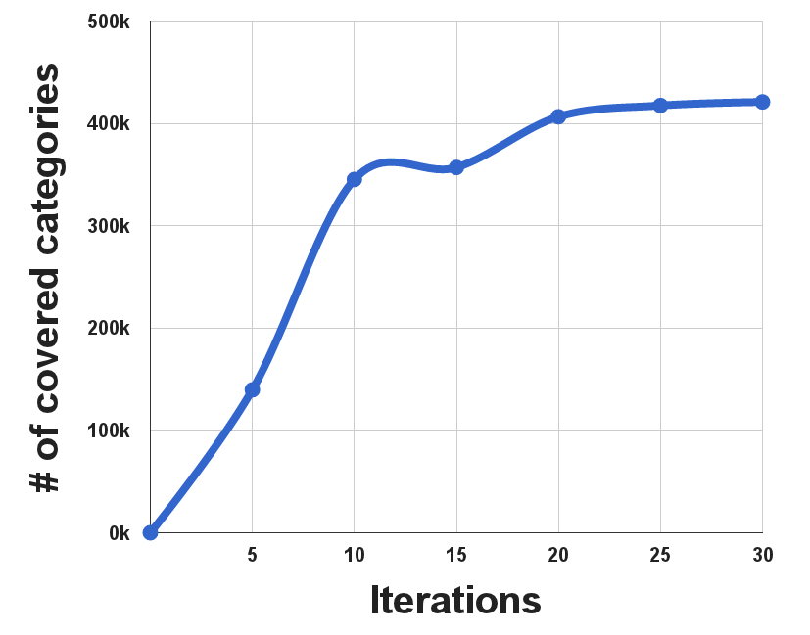
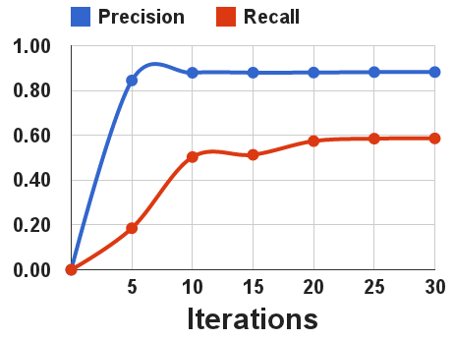
Category taxonomy evaluation

Slide 41
The story so far
2
Notes:
We have obtained a first version of the page taxonomy

Slide 42
The WiBi category taxonomy refinement
3

Slide 43
Category taxonomy refinement
Some categories are affected by some structural problems.
No pages
associated!
Comics characters
Comics characters by protagonist
Garfield characters
pages
categories

Slide 44
Category taxonomy refinement
3 refinement procedures to obtain broader coverage for categories
Single super category
Sub-categories
Super-categories

Slide 45
Single super category
Fictional characters by medium
So we promote its only super category to hypernym
This category has only 1 outgoing edge
Animated characters
Comics characters
Animation
Comics characters by protagonist
Animated television characters by series
Garfield characters
Notes:
Red edges belong to the taxonomy
Grey edges are the underlying network edges

Slide 46
Sub-categories
Focus on subcategories which have already been covered!
Comics by company
Comics characters
Comics characters by company
Comics titles by company‎
Marvel Comics characters
DC Comics characters
Disney comics‎

Slide 47
Sub-categories
Focus on subcategories which have already been covered!
Comics by company
Comics characters
2 paths ending in v
Comics characters by company
Only 1 path ending in u
Comics titles by company‎
Marvel Comics characters
DC Comics characters
Disney comics‎

Slide 48
Super-categories
Focus on super categories which have already been covered!
?
?

Slide 49
Super-categories
3 paths ending here

Slide 50
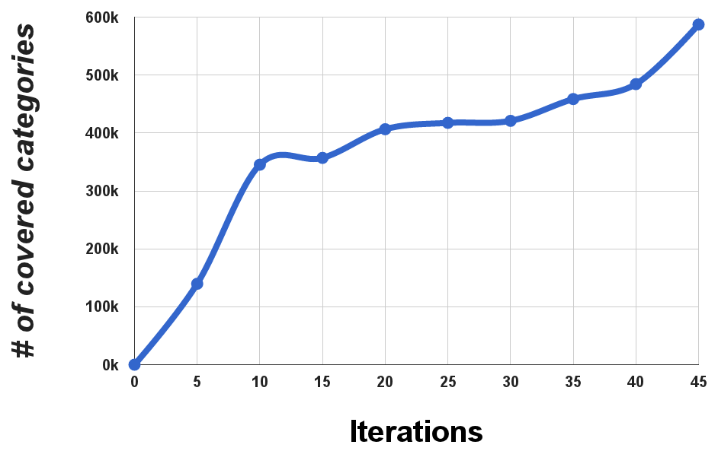
Category taxonomy evaluation: coverage
+50%
categories
covered!
1SUP
SUB
SUPER
Notes:
1 sentence: thanks to the 3 heuristics, we are able to cover around 50% more categories than before

Slide 51
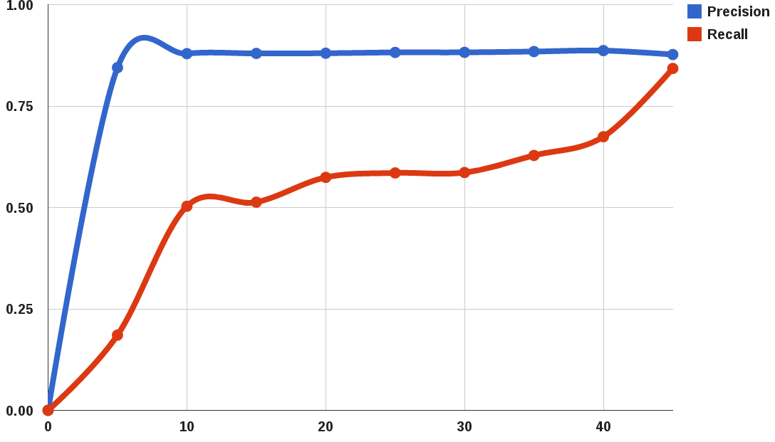
Category taxonomy evaluation: P & R
86%
+35%
recall
1SUP
SUB
SUPER
Iterations
Notes:
First iterations contribute the most and after, around iteration number 30, convergence is reached (attesting around 86%) thanks to the refinement phase.

Slide 52
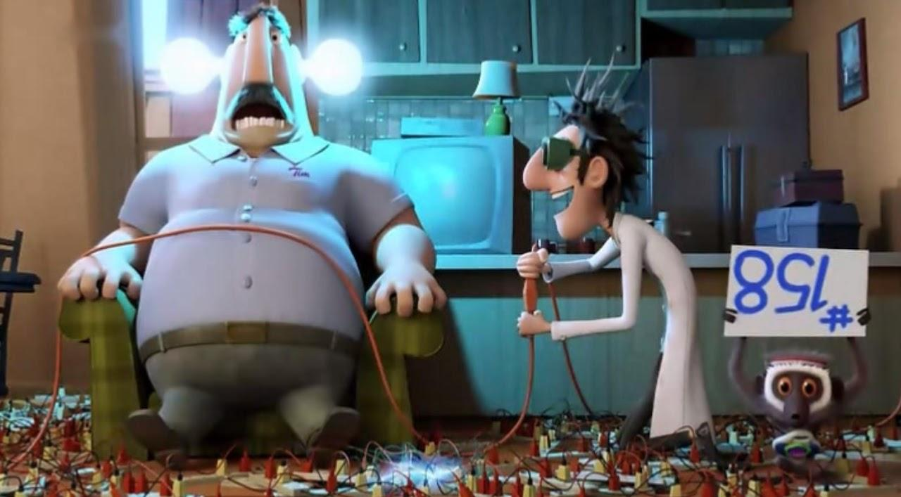
Experimental setup
We created 2 datasets:
1000 randomly sampled pages;
1000 randomly sampled categories.
Each item was annotated with the most suitable generalization (lemma+page or category).
Notes:
We created 2 datasets, both for pages and categories, of 1000 items each.

Slide 53
Competitors
WikiNet
MENTA
WikiTaxonomy
pages
categories
Notes:
We compared against all SOTA systems
With the exception of MENTA, all knowledge resources provide partial information either on pages or categories.
Additionally they do not provide a full taxonomy as we do, instead.
Finally most of the resources are heterogenous hypernyms, drawn from Wikipedia+WordNet (YAGO e MENTA) and Dbpedia inventories.
NOTA: we also have the highest taxonomy while for example YAGO flattens a lot.

Slide 54
Wikipedia editions
WiBi + WikiTax
YAGO
MENTA
WikiNet
DBpedia
Apr 2010
Jan 2012
Jun 2012
Oct 2012
Dec 2012
2011

Slide 55
Measures
We calculated typical measures to assess the quality of all the possible taxonomies;
Precision
Recall
Coverage
Specificity
Granularity

Slide 56
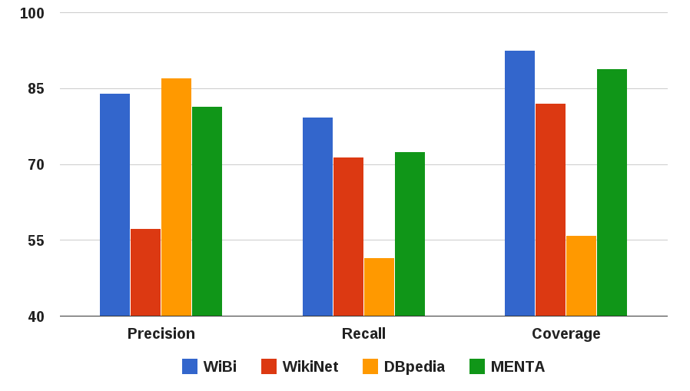
Page taxonomy comparison

Slide 57
Page taxonomy comparison

Slide 58
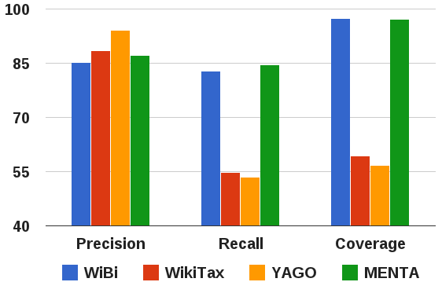
Category taxonomy comparison

Slide 59
Category taxonomy comparison

Slide 60
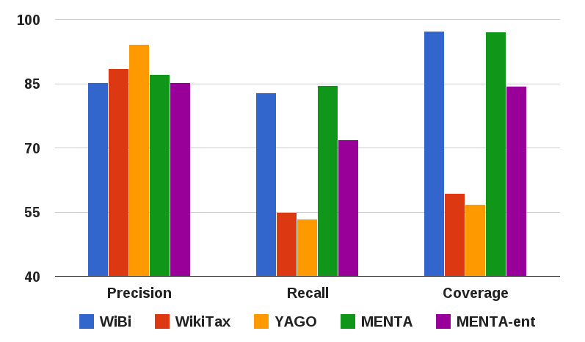
Category taxonomy comparison
Specificity
measure

Slide 61
Measuring specificity
A system is more specific than another when the hypernym(s) provided by the former are more specific/informative than the latter.
“Frank Sinatra is a”
System 1
“Singer”
<
System 2
“Swing singer”
less specific than

Slide 62
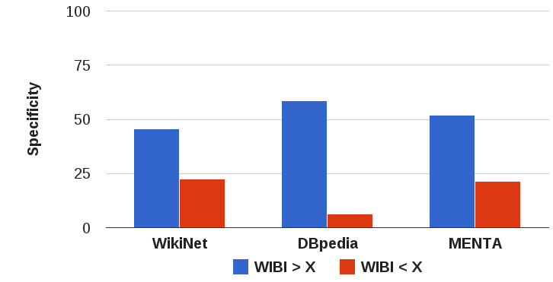
Page taxonomy specificity
Ratio of the times in which WiBi provided a more specific answer than the other system

Slide 63
Page taxonomy specificity
Ratio of the times in which WiBi provided a less specific answer than the other system

Slide 64
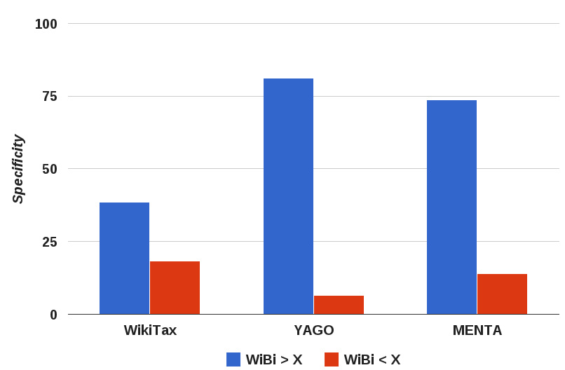
Category taxonomy specificity

Slide 65
Measuring granularity
Bad system
# of taxonomy links
Good system
Bad system
# of distinct hypernyms

Slide 66
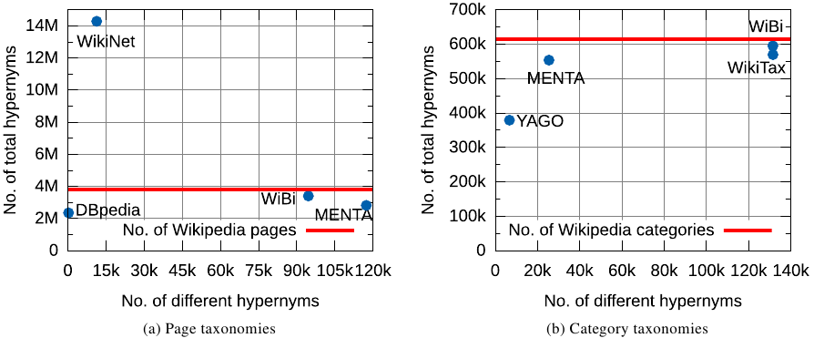
Measuring granularity
pages
categories
Notes:
1 sentence, 20’’

Slide 67
Conclusions
Unified, 3-phase approach to the construction of a bitaxonomy for the English Wikipedia;
Self-contained, no additional resources or supervision required;
Nearly full coverage of Wikipedia pages and categories;
State-of-the-art performance both on pages and categories.
wibitaxonomy.org

Slide 68
Tiziano Flati, Daniele Vannella, Tommaso Pasini, Roberto Navigli
Linguistic Computing Laboratory
lcl.uniroma1.it
Notes:
68

Slide 69
Why another Wikipedia taxonomy?
Hand-made/collaborative, little size
High coverage, but noisy
MENTA
Heterogeneous
WikiNet
Incomplete
MENTA
Partial
Only pages
Only categories
WikiNet
WikiTaxonomy

Slide 70
Measuring granularity
Entity
System that links all the N pages to 2 concepts
Person

Slide 71
Measuring granularity
System that links 1 page to M different concepts

