Slide 1
Rate-Limited Secure Function Evaluation
21. Public Key Cryptography, March 1st, 2013
Özgür Dagdelen*
Technische Universität Darmstadt; Germany
Payman Mohassel
University of Calgary, Canada
Daniele Venturi
Aarhus University, Denmark
(based on slides by Daniele)

Slide 2
Two-party SFE
f = (f_{A}, f_{B})
Input x_{A}
protocol $π$
Input x_{B}
y_{A} = f_{A}(x_{A},x_{B})
y_{B} = f_{B}(x_{A},x_{B})
Any functionality can be computed securely [Yao82,Yao85,GMW89,…]
By now, several real-world deployments [Fairplay (‘04), Sharemind (‘08), DGKN09,…]

Slide 3
Special-purpose SFE
Oblivious Polynomial Evaluation (OPE)
Secure non-adaptive keyword search [FIPR05]
holds a database D=(x_{i},v_{i}) and can search for keyword w
Privacy preserving data mining [LP02]
and hold databases D_{A},D_{B} and wish to apply data-mining algorithm to the joint database D_{A} $∪$ D_{B}
Oblivious Branching Programs (OBP)
Just another function representation
Input $x∈{\left\{0,1\right\}}^{n}$ induces a computation path from an initial node to a terminal node, whose label determines P(x)
Secure protocols for any length-bounded BP [IP07]
f = (p(.),-), field$𝔽$
$$x∈𝔽$$
$$\left(p_{0},…, p_{n}\right)$$
$$y_{A}=p\left(x\right)$$
$$y_{B}=−$$
$$x=\left(x_{1},…, x_{n}\right)$$
$$y_{A}=P\left(x\right)$$
$$y_{B}=−$$

Slide 4
Oracle Attacks & Secure Metering
A shared feature of the previous examples is that they are thought for multiple executions
Oracle Attacks.
Given black-box access to an oracle $𝒪_{f}$, query the functionality adaptively the private function
Secure Metering.
Service providers charge clients according to their level of usage
$$𝒪_{f}$$
Can be applied to any secure implementation which realizes the black-box functionality
In OPE, n+1 distinct inputs interpolates p(.) !!
A location-based service based on the number of locations
A database owner based on the number of distinct search queries
An IDS provider based on the number of suspicious files sent for vulnerability analysis

Slide 5
Enforcing rate $𝓻$
f = (f_{A}, f_{B})
Input x_{A}
protocol $π$
Input x_{B}
$$y_{A}^{1}= fA(x_{A}^{1},x_{B}^{1})$$
$$y_{B}^{1}=fB(x_{A}^{1},x_{B}^{1})$$
$$y_{A}^{2}= fA(x_{A}^{2},x_{B}^{2})$$
$$y_{B}^{2}= fB(x_{A}^{2},x_{B}^{2})$$
$$y_{A}^{3}= fA(x_{A}^{3},x_{B}^{3})$$
$$y_{B}^{3}= fB(x_{A}^{3},x_{B}^{3})$$
Naïve solution: Abort exactly after $𝓇$ executions
Repeating the same query should not be disallowed by default !
Useless in oracle attacks
Clients often do not keep state
Communication errors or device upgrades
Prove the validity of the outcome to a third-party

Slide 6
Outline
Definitions
Rate-Hiding
Rate-Revealing
Pattern-Revealing
Compilers
Stateful
Stateless
Instantiation
OPE

Slide 7
Definitions

Slide 8
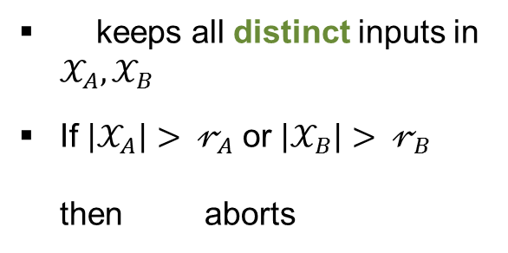
Rate-Limited Secure Function Evaluation (RL-SFE)
real
ideal
$π$
$$x_{A}^{j}$$
$$x_{B}^{j}$$
$$x_{A}^{j},y_{A}^{j}$$
$$x_{B}^{j},y_{B}^{j}$$
$$y_{A}^{j}$$
$$y_{B}^{j}$$
$∀ ∃$ s.t. view$π$( , ) = view$f$( , )
Rate-Hiding: learns only whether rate is exceeded
Rate-Revealing: learns current rate $\left|𝒳_{B}\right|$
Pattern-Revealing: learns the first occurance $J_{B}$ of ‘s input
keeps all distinct inputs in $𝒳_{A}, 𝒳_{B}$
If $\left|𝒳_{A}\right|> 𝓇_{A}$ or $\left|𝒳_{B}\right|> 𝓇_{B}$ then aborts

Slide 9
Commit-first SFE
Any SFE, where the parties are committed to their inputs
In an ideal implementation, must be able to extract the input and the randomness for the commitment
We build compilers transforming any cf-SFE into an RL-SFE
Intuition: exhibit some argument to convince the other party that the current commitment hides an already used value
f = (f_{A}, f_{B})
protocol $π_{f}^{1}$
Input x_{A}
Input x_{B}
C(x_{B};r_{B})
C(x_{A};r_{A})
protocol $π_{f}^{2}$
$$y_{A}=f_{A}\left(x_{A}, x_{B}\right)$$
$$y_{B}=f_{B}\left(x_{A},x_{B}\right)$$

Slide 10
Instantiations of cf-SFE
General Compilers
GMW compiler: semi-honest SFE → malicious SFE
Input-committing, coin-generation, protocol emulation phase
Yao‘s garbled circuits: general purpose 2-party SFE
One-sided commit-first (w.r.t. the “evaluator“) if OT is commit-first
Jarecki-Shmatikov: variant of Yao w/ UC-sec in CRS model
With a slight modification: replacing Camenisch-Shoup Enc with e.g. Paillier
Specific protocols
Private Set Intersection [HN10]
Oblivious Automata Evaluation [GHS10]
Oblivious Polynomial Evaluation [HL08]

Slide 11
Compilers

Slide 12

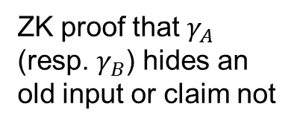
A rate-revealing ($𝓻_{A},𝓻_{B}$)-limited compiler
Let $π_{f}=\left(π_{f}^{1},π_{f}^{2}\right)$ be a commit-first SFE for $f=\left(f_{A},f_{B}\right)$
protocol $π_{f}^{1}$
x_{A} , $Γ_{A}$
x_{B} , $Γ_{B}$
Theorem:
cf-SFE $π_{f} \underset{⇒}{RR−compiler}$ rate-revealing ($𝓻_{A},𝓻_{B}$)-limited SFE
$γ_{B}^{j}$ = C(x_{B};r_{B})
$γ_{A}^{j}$ = C(x_{A};r_{A})
protocol $π_{f}^{1/2}$
$$Γ_{A} :=Γ_{A} ∪\left\{x_{A}^{j},r_{A}^{j}\right\}$$
ZK proof that $γ_{A}$ (resp. $γ_{B}$) hides an old input or claim not
$$Γ_{B} :=Γ_{B} ∪\left\{x_{B}^{j},r_{B}^{j}\right\}$$
If proof fails, decrease $𝓻_{B}$
If proof fails, decrease $𝓻_{A}$
$$Γ_{A} :=Γ_{A} ∪γ_{B}^{j}$$
$$Γ_{A} :=Γ_{A} ∪γ_{A}^{j}$$
protocol $π_{f}^{2}$
$$y_{A}^{j}=f_{A}\left(x_{A}^{j},x_{B}^{j}\right)$$
$$y_{B}^{j}=f_{B}\left(x_{A}^{j},x_{B}^{j}\right)$$

Slide 13

Description of the simulator
Theorem: If $π_{f}$ is a commit-first protocol securely computing f against malicious adversaries, then the protocol from the previous slide is a rate-revealing ($𝓻_{A},𝓻_{B}$)-limited SFE
$${x′}_{A}^{j}, {r′}_{B}^{j}$$
$${γ′}_{B}^{j}$$
, $y_{A}^{j}$
$${x′}_{A}^{j}$$
$$x_{A}^{j}$$
$$y_{A}^{j}, |𝒳_{B}|$$
cf₁
ZK
cf₂

Slide 14
Proof Sketch
In the first experiment, the simulator updates the state on the basis of the verification of the ZK proofs
Indistinguishability follows from the soundness of the ZK proof
In the second experiment, the real input of the honest party is used for the simulation
Indistinguishability follows from the hiding property of the commitment scheme
In the third experiment, we replace the simulated ZK proof, with an actual ZK proof
Indistinguishability follows from the zero-knowledge property of the proof

Slide 15
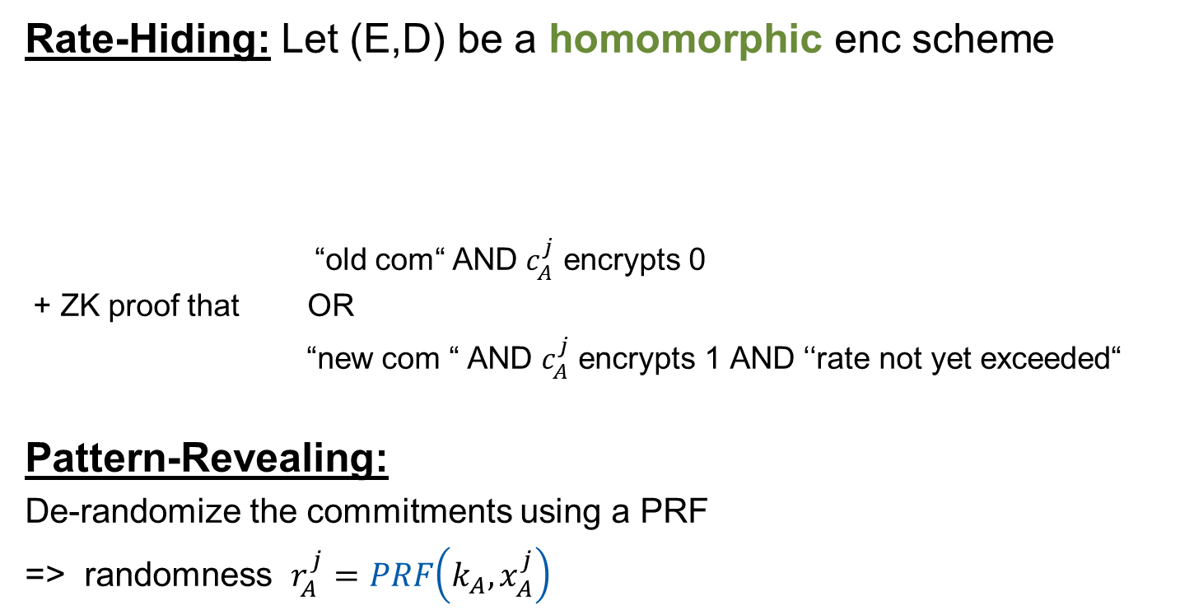
More Compilers
Rate-Hiding: Let (E,D) be a homomorphic enc scheme
“old com“ AND $c_{A}^{j}$ encrypts 0
+ ZK proof that OR
“new com “ AND $c_{A}^{j}$ encrypts 1 AND ‘‘rate not yet exceeded“
Pattern-Revealing:
De-randomize the commitments using a PRF
=> randomness $r_{A}^{j}=PRF\left(k_{A}, x_{A}^{j}\right)$
$$γ_{A}^{j}$$
$$γ_{A}^{j}$$
$$c_{A}^{j}←E(pk,1)$$
$$c_{A}^{j}←E(pk,0)$$
fresh $x_{A}^{j}$
non-fresh $x_{A}^{j}$

Slide 16
Making the compilers stateless
RL-SFE impossible when both parties are stateless
Possible in the client/server setting where the clients can only store a little state
Let (T,V) be an MAC, (E,D) be an SKE and H be a CRHF
At the beginning of each round transmits a list of commitments, a list of ciphertexts and a tag $φ^{′}$
can verify the state, extract old inputs and obtain a witness for the ZK proof
$$c←E\left(k,x_{A}\right) \hat{c}←E\left(k,r_{A}\right)$$
$$φ=T\left(k^{′}, H\left(γ^{1},γ^{2},…, γ\right)\right) γ=C(x_{A};r_{A})$$
$$\left(c,\hat{c}\right),φ, γ$$

Slide 17
Applications

Slide 18
Hazay-Lindell OPE
Let (E,D) be a homomorphic enc scheme
${\left\{E\left(pk, x^{j}\right)\right\}}_{j}$ and a ZK proof of its validity constitutes a commitment to x
In fact, can extract input x and the randomness
The protocol is one-sided commit-first
We give efficient proofs of repeated-inputs for all compilers
f = (p(.),-), field$𝔽$
$$x∈𝔽$$
pk + “valid key“
$$\left(p_{0},…, p_{n}\right)$$
${\left\{E\left(pk, x^{j}\right)\right\}}_{j}$ + “valid ciphertext“
$$y_{A}=p\left(x\right)$$
$$y_{B}=−$$
…….

Slide 19
Conclusion

Slide 20
Conclusion
Rate-Limited Secure Function Evaluation
Secure metering
Oracle attacks
Auxiliary notion: commit-first SFE
Existing generic compilers and specific protocols
Compilers for
Rate-Hiding RL-SFE
Rate-Revealing RL-SFE
Pattern-Revealing RL-SFE
Instantiation
OPE [HL08]
STATELESS
(constant)

Slide 21
Thank you! Questions? eprint.iacr.org/2013/021

Slide 22
Possible extensions:
Concurrent executions + UC-security
Efficient compiler from any SFE
not necessarily commit-first
Avoid ZK proofs (using simpler machinery)

